Slide 1
My SQL – Loan Customer Analysis
~Presented by Dharun Rajesh M

Slide 2
What’s in it for you?
What is a Database?
What is the need of a database?
What is SQL?
Types of SQL server
Features of SQL
Applications of SQL
SQL Commands
SQL Data Types
Difference between DBMS & RDBMS
Triggers in SQL
SQL server stored procedure

Slide 3

What is a Database?
A database is a vast collection of data that is stored and retrieved electronically from a system.
This structured data stored in the database is processed, manipulated, controlled and updated to perform various operations.

Slide 4




What is the need of a Database?
Manage Vast volumes of data
Manipulate and update data
Keeps your data safe and secure
Make meaningful decisions

Slide 5

What is SQL?
Structured Query Language
SQL is a standard programming language used for operating Relational Databases and to carry every operation such as inserting, manipulating, updating and retrieving data from relational databases

Slide 6
Types of SQL servers
Oracle
My SQL workbench
Mango DB
Navigation
No SQL
MS server

Slide 7

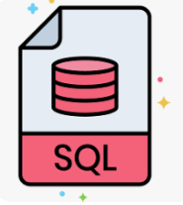



Features of SQL
SQL lets you access any data within the relation database
SQL is very fast in retrieving large amounts of data very efficiently
SQL is versatile as it works with database system from Oracle, IBM, Microsoft, etc.
SQL helps you manage databases without knowing lot of coding

Slide 8




Applications of SQL
SQL is used to create a database, define its structure, implement it and let’s you perform many functions
SQL is also used for maintaining an already existing database. SQL is a powerful language for entering data, modifying data and extracting data in a database
SQL is extensively used as a Client/Server language to connect the front-end with the back-end thus supporting the client/server architecture
SQL when deployed as Data Control Language(DCL) helps protect your database from unauthorized access

Slide 9
SQL Commands
DDL
DML
TCL
DQL
DCL
Create
Drop
Alter
Truncate
Insert
Update
Delete
Commit
Rollback
Save point
Select
Grant
Revoke

Slide 10
Numeric
Bit, tinyint , smallint , int,bigint, decimal, numeric, float, real
Date / Time
Date, Time, Date time, Timestamp
Character / String
Char, Varchar, Varchar(max), Text
SQL Data Types
Unicode character / String
Nchar, Nvarchar, Nvarchar (max), NText
Binary
Binary, Varbinary, Varbinary (max), image
Miscellaneous
Clob, Blob, XML, JSON

Slide 11
Difference between DBMS and RDBMS
DBMS
RDBMS
DBMS stands for “Database Management System”.
RDBMS stands for “Relational Database Management System”.
DBMS technology stores the data in the form of files.
RDBMS stores the data in the form of tables.
DBMS is designed to handle small amounts of data.
RDBMS is designed to deal with vast amount of data.
DBMS provides support only for a single user at a time.
RDBMS provides support for multiple users at a time.

Slide 12

Triggers in SQL
APPLICATION
Table
INSERT TRIGGER
UPDATE TRIGGER
DELETE TRIGGER

Slide 13


SQL Server Stored Procedure
SQL Statement
Data

Slide 14
To Create Database
Create:
This command is used to create database or table.
Syntax for Database creation:
Create database database_name;
Query:
Create database Project_1;

Slide 15
To Create Table
Syntax for Table creation:
Create table table_name;
Query:
Table 1:
Create table Loan_status2 (Loan_id varchar(45), Customer_id varchar(30), Loan_amount varchar(100), Loan_amount_term int, Cibil_score int, primary key (loan_id));
Table 2:
Create table Remarks_update1 (Loan_id varchar(45), Loan_amount int, Cibil_score int, Cibil_score_status varchar(100), primary key (loan_id)); alter table remarks_update1 modify loan_amount varchar(100);

Slide 16
Trigger creation
To create trigger on loan_status2 (Timing – after insert)
Delimiter $$ create trigger remarks1 after insert on loan_status2 for each row begin if new.cibil_score >900 then insert into remarks_update1 values (new.loan_id, new.loan_amount, new.cibil_score, 'High_cibil_score’); elseif new.cibil_score >750 then insert into remarks_update1 values (new.loan_id, new.loan_amount, new.cibil_score, 'No_penalty’); elseif new.cibil_score >250 then insert into remarks_update1 values (new.loan_id, new.loan_amount, new.cibil_score, 'Penalty_customers’); elseif new.cibil_score <=0 then insert into remarks_update1 values (new.loan_id, new.loan_amount, new.cibil_score, 'Reject_customers(Loan_cannot_apply)’); end if; end $$ Delimiter ;

Slide 17
To create trigger on loan_status2 (Timing – before insert)
Delimiter $$ create trigger Loan_check before insert on loan_status2 for each row begin if new.loan_amount is null then set new.loan_amount = "Loan_still_processing"; end if; end $$ delimiter ;

Slide 18
To insert values into table
Insert:
This command is used to insert a single or multiple records in a table.
Syntax:
Insert into (table name) values (value);
Query:
Insert into loan_status2 values
('LP001002', 'IP43001', Null, 360, 303), ('LP001003', 'IP43002', 128, 360, 920), ('LP001005', 'IP43003', 66, 360, 606), ('LP001006', 'IP43004', 120, 360, 851), ('LP001008', 'IP43005', 141, 360, 420), ('LP001011', 'IP43006', 267, 360, 173),

Slide 19
('LP001013', 'IP43007', 95, 360, 650), ('LP001014', 'IP43008', 158, 360, 471), ('LP001018', 'IP43009', 168, 360, 863), ('LP001020', 'IP43010', 349, 360, 730), ('LP001024', 'IP43011', 70, 360, 143), ('LP001027', 'IP43012', 109, 360, 384), ('LP001028', 'IP43013', 200, 360, 928), ('LP001029', 'IP43014', 114, 360, 455), ('LP001030', 'IP43015', 17, 120, 564), ('LP001032', 'IP43016', 125, 360, 477), ('LP001034', 'IP43017', 100, 240, 888), ('LP001036', 'IP43018', 76, 360, 387), ('LP001038', 'IP43019', 133, 360, 371), ('LP001041', 'IP43020', 115, 0, 537), ('LP001043', 'IP43021', 104, 360, 534), ('LP001046', 'IP43022', 315, 360, 903), ('LP001047', 'IP43023', 116, 360, 615), ('LP001050', 'IP43024', 112, 360, 593), ('LP001052', 'IP43025', 151, 360, 79),

Slide 20
('LP001066', 'IP43026', 191, 360, 293), ('LP001068', 'IP43027', 122, 360, 999), ('LP001073', 'IP43028', 110, 360, 781), ('LP001086', 'IP43029', 35, 360, 521), ('LP001087', 'IP43030', 120, 360, 620), ('LP001091', 'IP43031', 201, 360, 972), ('LP001095', 'IP43032', 74, 360, 425), ('LP001097', 'IP43033', 106, 360, 420), ('LP001098', 'IP43034', 114, 360, 667), ('LP001100', 'IP43035', 320, 360, 889), ('LP001106', 'IP43036', Null, 360, 460), ('LP001109', 'IP43037', 100, 0, 413), ('LP001112', 'IP43038', 144, 360, 139), ('LP001114', 'IP43039', 184, 360, 812), ('LP001116', 'IP43040', 110, 360, 71), ('LP001119', 'IP43041', 80, 360, 374), ('LP001120', 'IP43042', 47, 360, 472), ('LP001123', 'IP43043', 75, 360, 881), ('LP001131', 'IP43044', 134, 360, 80), ('LP001136', 'IP43045', 96, 0, 760),

Slide 21
('LP001137', 'IP43046', 88, 0, 495), ('LP001138', 'IP43047', 44, 360, 197), ('LP001144', 'IP43048', 144, 360, 151), ('LP001146', 'IP43049', 120, 360, 733), ('LP001151', 'IP43050', 144, 360, 187), ('LP001155', 'IP43051', 100, 360, 808), ('LP001157', 'IP43052', 120, 360, 475), ('LP001164', 'IP43053', 112, 360, 359), ('LP001179', 'IP43054', 134, 360, 716), ('LP001186', 'IP43055', 286, 360, 546), ('LP001194', 'IP43056', 97, 360, 509), ('LP001195', 'IP43057', 96, 360, 160), ('LP001197', 'IP43058', 135, 360, 186), ('LP001198', 'IP43059', 180, 360, 781), ('LP001199', 'IP43060', 144, 360, 949), ('LP001205', 'IP43061', 120, 360, 629), ('LP001206', 'IP43062', 99, 360, 803), ('LP001207', 'IP43063', 165, 180, 889),

Slide 22
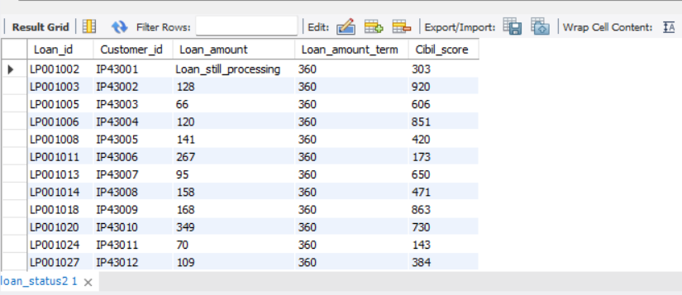
To view table with values
Syntax:
Select * from table_name;
Query:
Select * from loan_status2;
Output:

Slide 23
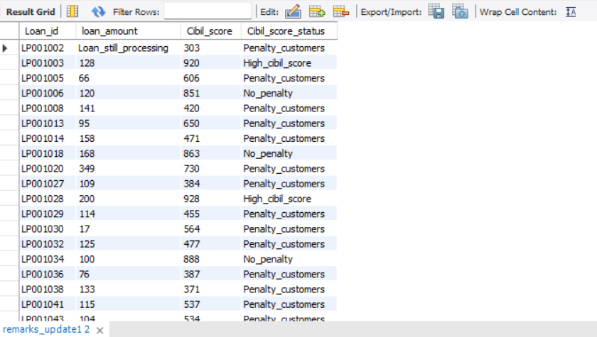
Query:
Select * from remarks_update1;
Output:

Slide 24
To join 2 tables using inner join
Query:
Select loan_status2.loan_id, loan_status2.customer_id, loan_status2.loan_amount, loan_status2.loan_amount_term, loan_status2.cibil_score, remarks_update1.cibil_score_status from loan_status2 inner join remarks_update1 on loan_status2.loan_id = remarks_update1.loan_id;
To create table:
Create table cibil_score_update1 select loan_status2.loan_id, loan_status2.customer_id, loan_status2.loan_amount, loan_status2.loan_amount_term, loan_status2.cibil_score, remarks_update1.cibil_score_status from loan_status2 inner join remarks_update1 on loan_status2.loan_id = remarks_update1.loan_id;

Slide 25
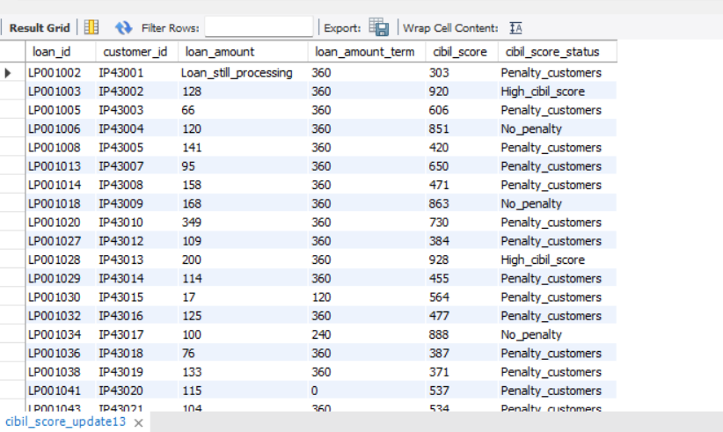
Query:
Select * from cibil_score_update1;
Output:

Slide 26
To import data
In MySQL Workbench, on the Navigator pane, select Data Import/Restore.
Select the project folder or self-contained SQL file, select the schema to import into, or select the New button to define a new schema.
Select Start Import to begin the import process.
Importing Tables:
Import customer_income table
Import customer_info table
Import country_state table
Import region_info table

Slide 27
To join all tables using inner join & Table creation
Query:
Create table Loan_details Select cibil_score_update1.loan_id, cibil_score_update1.customer_id, cibil_score_update1.loan_amount, cibil_score_update1.loan_amount_term, cibil_score_update1.cibil_score, cibil_score_update1.cibil_score_status, customer_income.applicant_income, customer_income.coapplicant_income, customer_income.Property_Area, customer_income.Loan_Status, customer_info.customer_name, customer_info.gender, customer_info.age, customer_info.married, customer_info.education, customer_info.self_employed, customer_info.region_id, country_state.postal_code, country_state.segment, country_state.state, region_info.region from cibil_score_update1 inner join customer_income on cibil_score_update1.loan_id = customer_income.loan_id inner join customer_info on cibil_score_update1.customer_id = customer_info.customer_id inner join country_state on cibil_score_update1.loan_id = country_state.loan_id inner join region_info on country_state.region_id = region_info.region_id;

Slide 28
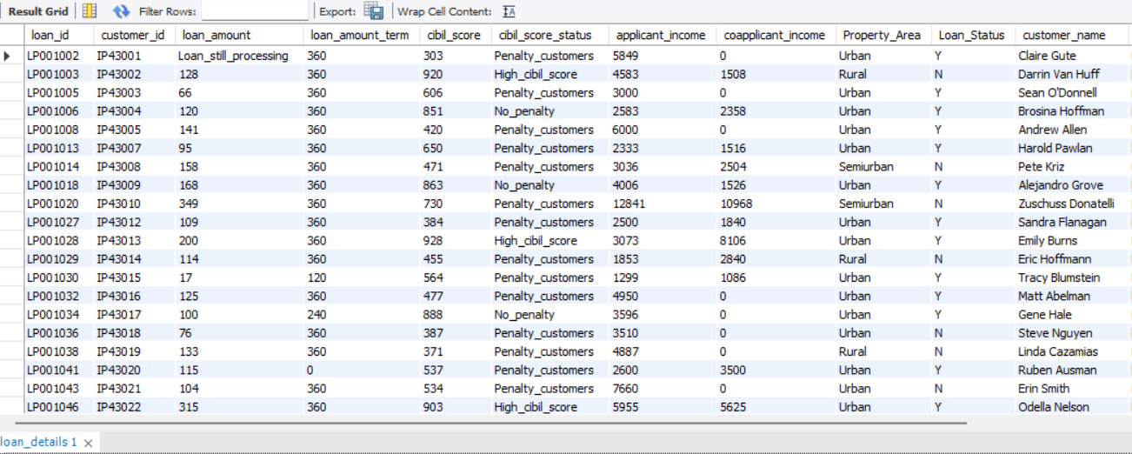
Select * from loan_details;
Output:

Slide 29
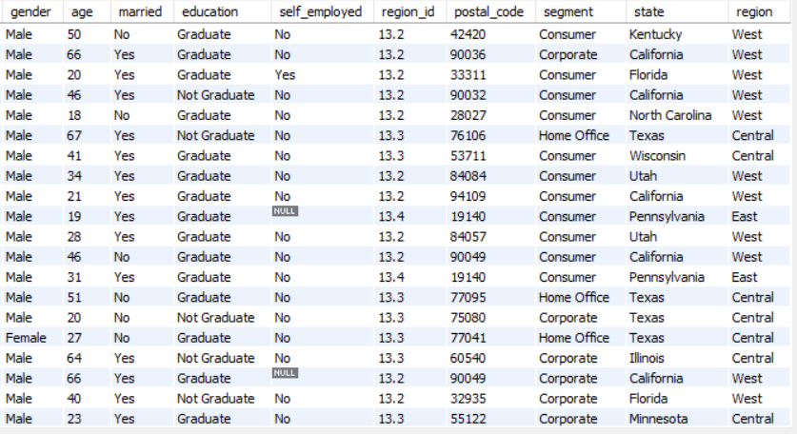

Slide 30
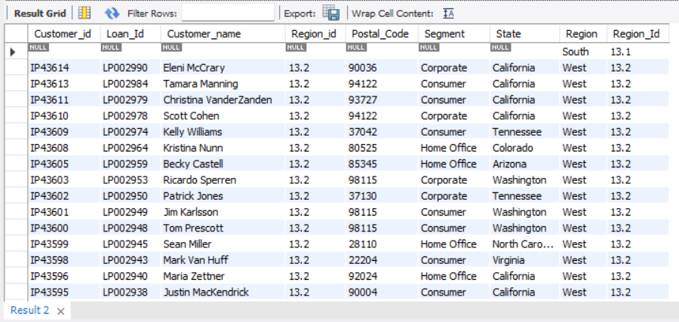
To show missing Region id using right join
Query:
Select * from country_state right join region_info on country_state.region_id = region_info.region_id;
Output:

Slide 31
To self join Customer criteria & Interest rate field
Query:
Create table loan_detail Select *, case when applicant_income >15000 then “A_Grade_customer” when applicant_income >9000 then “B_Grade_customer” when applicant_income >5000 then “Middle_class_customer” else “Low_class_customer” end as Customer_criteria, case when applicant_income <5000 and property_area = "Rural" then 5 when applicant_income <5000 and property_area = "Semirural" then 3.5 when applicant_income <5000 and property_area = "Urban" then 3 when applicant_income <5000 and property_area = "semiurban" then 2.5 else 7 end as Interest_rate from loan_details;

Slide 32
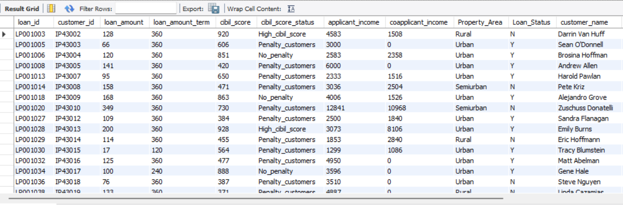
Select * from loan_detail;
Output:

Slide 33
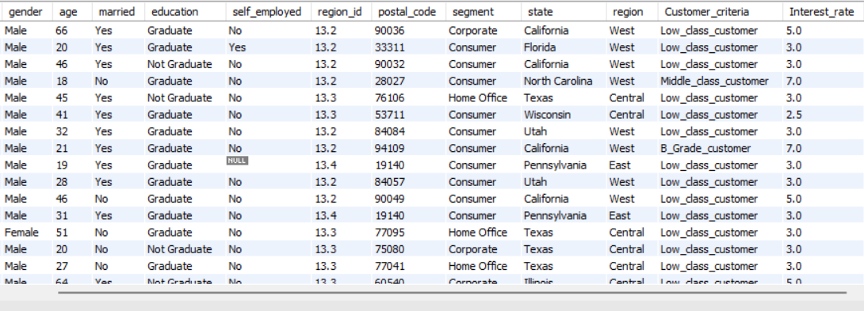

Slide 34
To self join Monthly interest & Annual Interest field
Query:
Select *, round((loan_amount * interest_rate/100),2) as Monthly_interest_amount, round((loan_amount * interest_rate/100 *12),2) as Annual_interest_amount from loan_detail;
Table creation:
Create table loan_det select *, round((loan_amount * interest_rate/100),2) as Monthly_interest_amount, round((loan_amount * interest_rate/100 *12),2) as Annual_interest_amount from loan_detail;

Slide 35
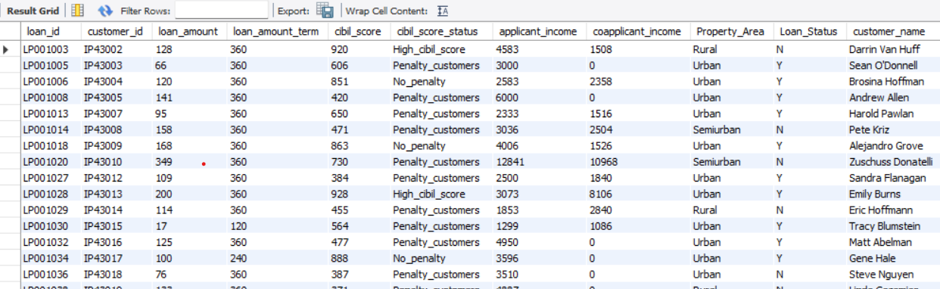
Select * from loan_det;

Slide 36
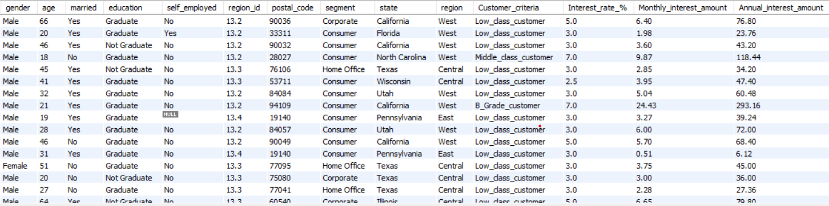

Slide 37
To update gender & age using customer id
Query:
update loan_det set gender = "Female" where customer_id = 'IP43006’; update loan_det set gender = "Female" where customer_id = 'IP43016’; update loan_det set gender = "Male" where customer_id = 'IP43018’; update loan_det set gender = "Male" where customer_id = 'IP43038’; update loan_det set gender = "Female" where customer_id = 'IP43508’; update loan_det set gender = "Female" where customer_id = 'IP43577’; update loan_det set gender = "Female" where customer_id = 'IP43589’; update loan_det set gender = "Female" where customer_id = 'IP43593’; update loan_det set age = 45 where customer_id = 'IP43007’; update loan_det set age = 32 where customer_id = 'IP43009';

Slide 38
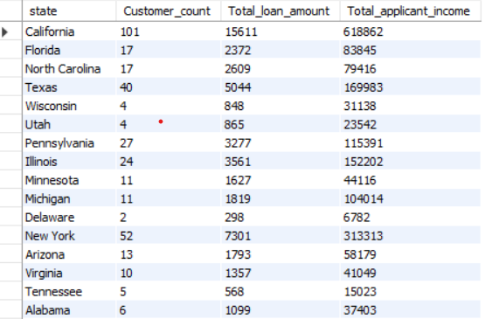
To filter state wise customer count, loan amount, applicant income using group by
Query:
Select state, count(customer_id) as Customer_count, sum(loan_amount) as Total_loan_amount, sum(applicant_income) as Total_applicant_income from loan_det group by state;
Output:

Slide 39
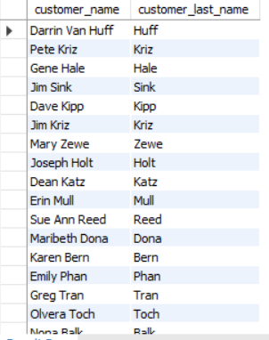
To filter last 4 character name after space from customer name
Query:
Select customer_name, right(customer_name, 4) as customer_last_name from loan_det where customer_name like '% ____’;
Output:

Slide 40
To store all output queries in procedure
Query:
Delimiter $$ create procedure Project() begin select * from loan_Details; select * from loan_det; select * from country_state right join region_info on country_state.region_id = region_info.region_id; select state, count(customer_id) as Customer_count, sum(loan_amount) as Total_loan_amount, sum(applicant_income) as Total_applicant_income from loan_det group by state; select customer_name, right(customer_name, 4) as customer_last_name from loan_det where customer_name like '% ____’; end $$ Delimiter ;

Slide 41
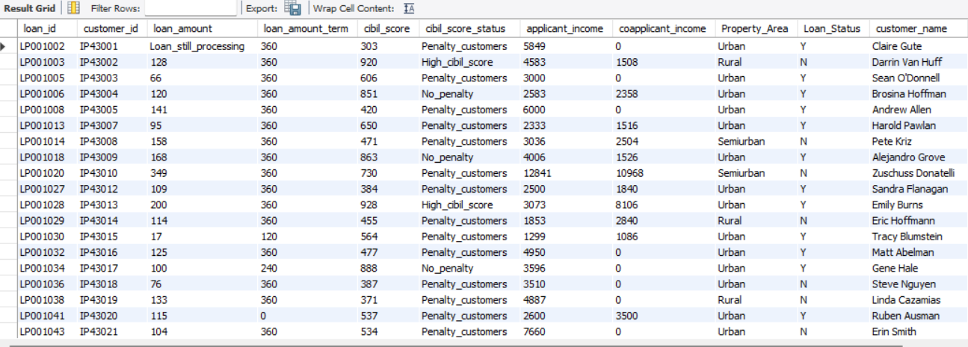
Call Project();
Output:
Result 6:

Slide 42
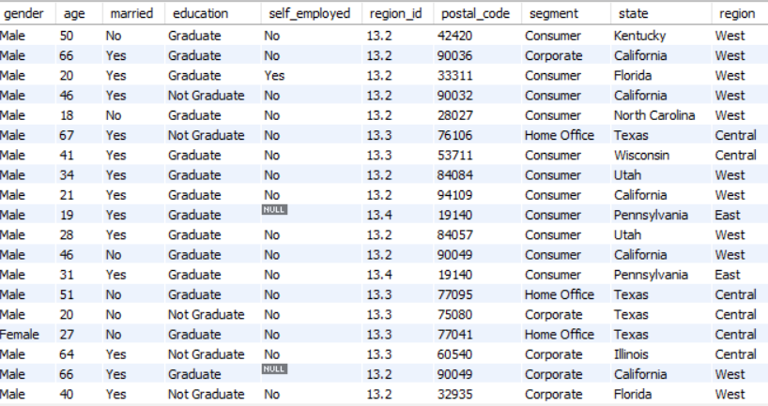

Slide 43
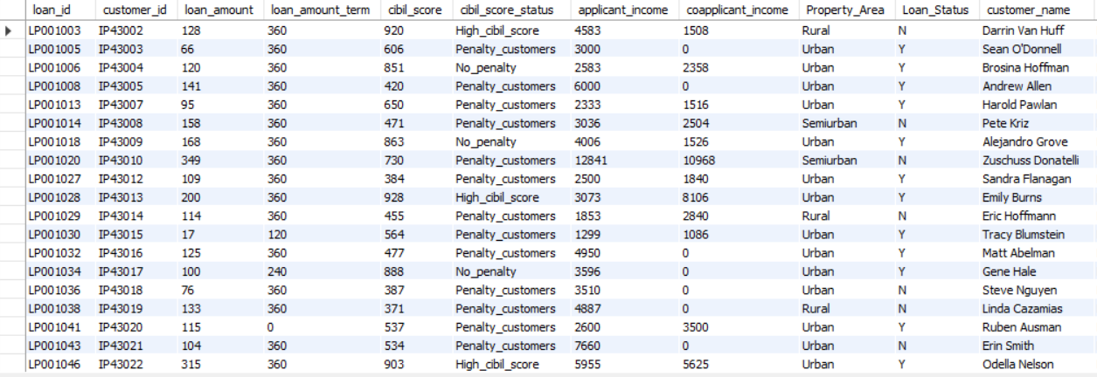
Result 7:

Slide 44
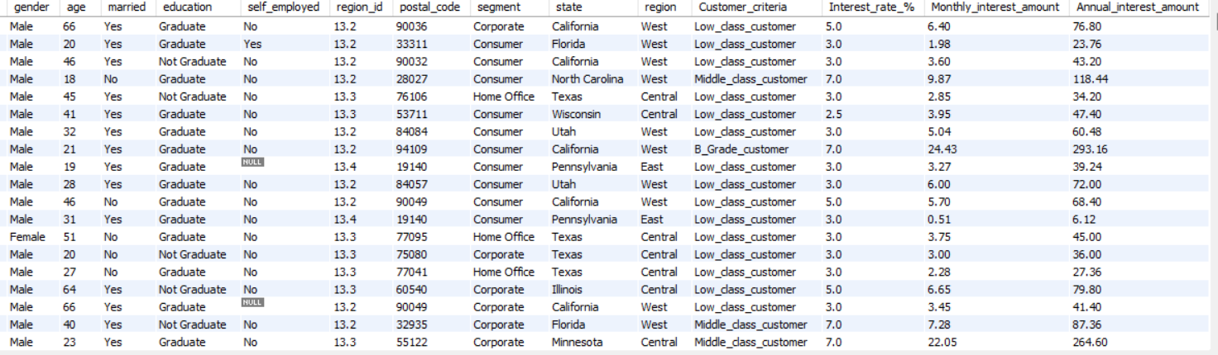

Slide 45
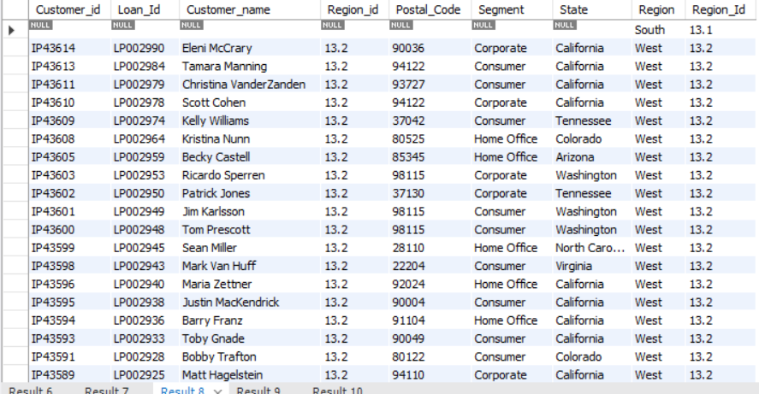
Result 8:

Slide 46
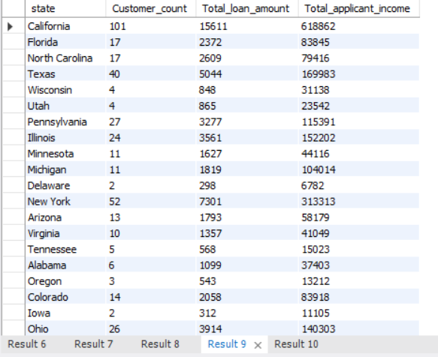
Result 9:

Slide 47
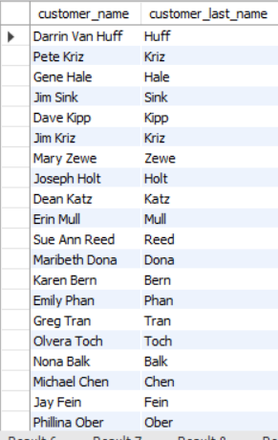
Result 10:

Slide 48
Thank you

